Slide 1
CSE213 - OBJECT ORIENTED ANALYSIS AND DESIGN
AY-2020-2021
SEMESTER-VI
JANUARY-MAY

Slide 2
MODULE-1
COURSE OUTCOMES:
Define the basic concepts of Object Oriented approaches

Slide 3
MODULE I
INTRODUCTION TO OBJECT ORIENTED SYSTEM
Object Basics-Object Oriented System Development Life Cycle- Use case driven
approach-Rumbaugh Object Model- Booch Methodology-Jacobson Methodology-Unified Approach

Slide 4
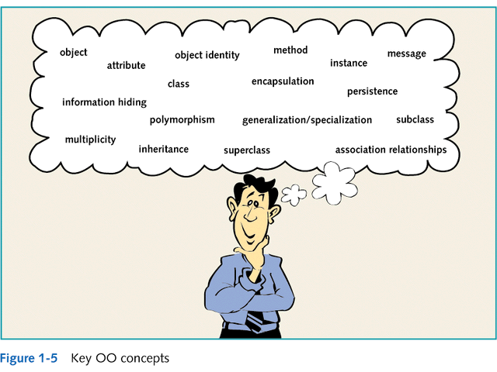

Slide 5
Objects
An object is a real-world element in an object–oriented environment that may have a physical or a conceptual existence. Each object has −
Identity that distinguishes it from other objects in the system.
State that determines the characteristic properties of an object as well as the values of the properties that the object holds.

Slide 6
Objects
Behavior that represents externally visible activities performed by an object in terms of changes in its state.
Objects can be modelled according to the needs of the application.
An object may have a physical existence, like a customer, a car, etc.; or an intangible conceptual existence, like a project, a process, etc.

Slide 7
Objects
Most basic component of OO design. Objects are designed to do a small, specific piece of work.
Objects represent the various components of a business system

Slide 8
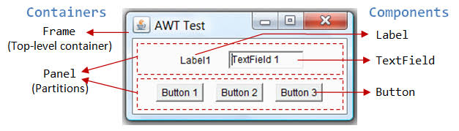
Examples of Different Object Types
GUI objects
objects that make up the user interface
e.g. buttons, labels, windows, etc.

Slide 9
Examples of Different Object Types
Problem Domain objects
Objects that represent a business application
A problem domain is the scope of what the system to be built will solve. It is the business application.
e.g. An order-entry system A payroll system A student system

Slide 10
Sample Problem Domain
Company ABC needs to implement an order-entry system that takes orders from customers for a variety of products.
What are the objects in this problem domain?
Hint: Objects are usually described as nouns.

Slide 11
Possible Objects for this Problem Domain
Customer
Order
Product

Slide 12
Classes and Objects
Class
A class represents a collection of objects having same characteristic properties that exhibit common behavior.
It gives the blueprint or description of the objects that can be created from it. Creation of an object as a member of a class is called instantiation. Thus, object is an instance of a class.

Slide 13
Classes and Objects
Classes
Define what all objects of the class represent
It is like a blueprint. It describes what the objects look like
They are a way for programs to model the real world
Objects
Are the instances of the class

Slide 14
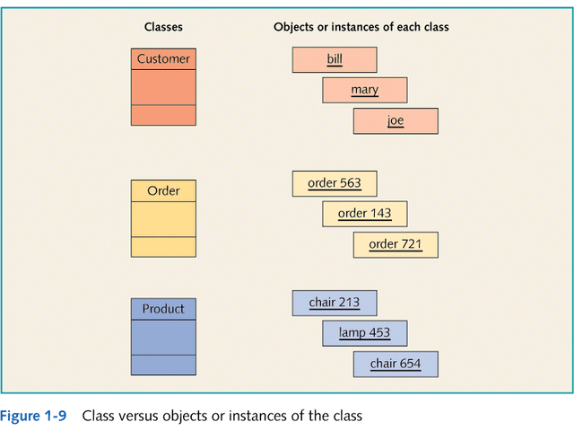

Slide 15
Object Attributes and Methods
Classes contain two things:
Fields (attributes, data members, class variables):
Data items that differentiate one object of the class from another. e.g. employee name, student number
Characteristics of an object that have values
What are some possible attributes for the customer object?
Methods (behaviors):
Named, self-contained blocks of code that typically operate on the fields
Describe what an object can do
Can be thought of as the verbs in a problem domain
What are some possible methods for the customer object?

Slide 16
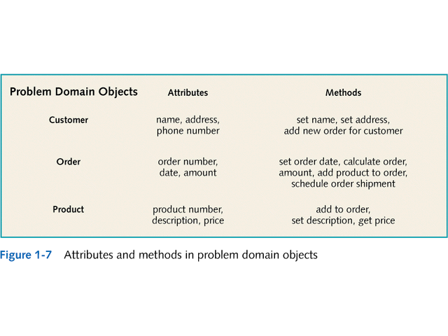

Slide 17
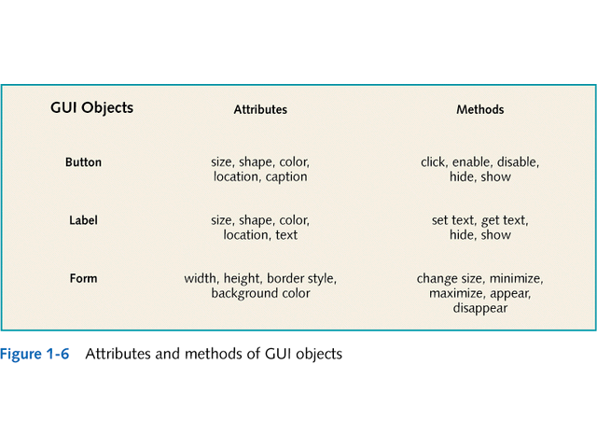

Slide 18
Class member: 1. data member 2. Behaviuor
Class SportsBicycle extends bicycle
{
Int tyre=0;
Void sporting(){}
}
Class bicycle{
int gear;
Void braking()
{sop(“I stop”);
}
}
Bicycle b1= new Bicycle();
Bicycle b2= new Bicycle();

Slide 19
Object Interactions and Messages
Objects interact with other objects in a variety of relationships
e.g. one-to-one, one-to-many
Messages
The means by which objects interact
Example:
User initiates interaction via messages to GUI objects
GUI objects interact with problem domain objects via messages
Problem domain objects interact with each other and GUI objects via messages
GUI objects respond to user via messages

Slide 20
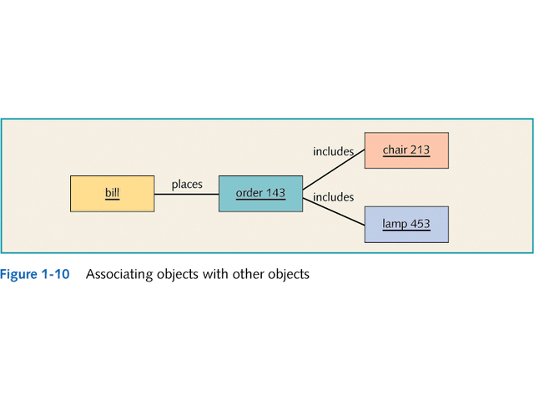

Slide 21
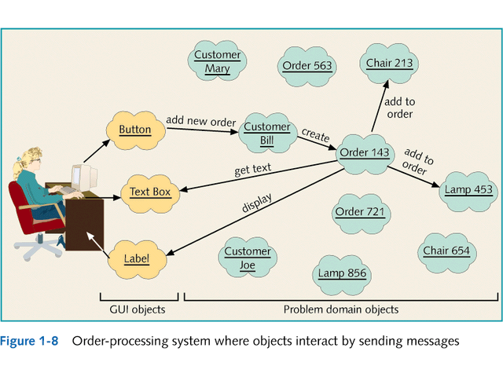

Slide 22
Inheritance and Polymorphism
Inheritance is the mechanism that permits new classes to be created out of existing classes by extending and refining its capabilities.
The existing classes are called the base classes/parent classes/super-classes, and the new classes are called the derived classes/child classes/subclasses.
The subclass can inherit or derive the attributes and methods of the super-class(es) provided that the super-class allows so.

Slide 23
Inheritance and Polymorphism
Besides, the subclass may add its own attributes and methods and may modify any of the super-class methods. Inheritance defines an “is – a” relationship.
Example
From a class Mammal, a number of classes can be derived such as Human, Cat, Dog, Cow, etc. Humans, cats, dogs, and cows all have the distinct characteristics of mammals. In addition, each has its own particular characteristics.
It can be said that a cow “is – a” mammal.

Slide 24
Types of Inheritance
Single Inheritance − A subclass derives from a single super-class.
Multiple Inheritance − A subclass derives from more than one super-classes.
Multilevel Inheritance − A subclass derives from a super-class which in turn is derived from another class and so on.
Hierarchical Inheritance − A class has a number of subclasses each of which may have subsequent subclasses, continuing for a number of levels, so as to form a tree structure.
Hybrid Inheritance − A combination of multiple and multilevel inheritance so as to form a lattice structure.

Slide 25
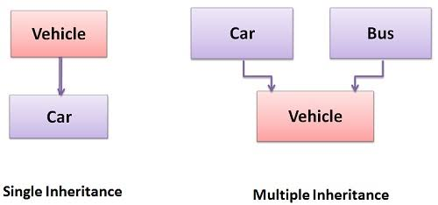
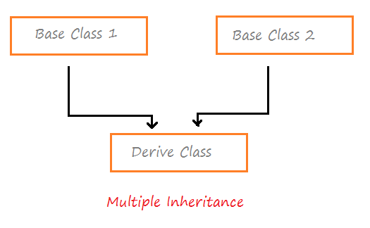

Slide 26
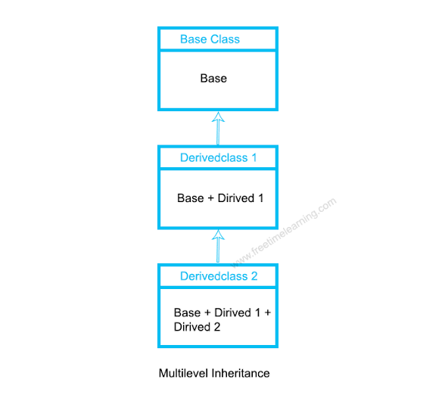
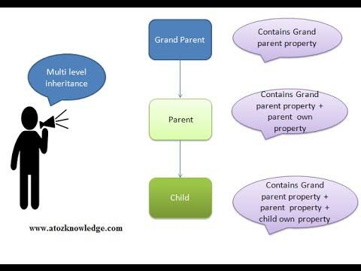

Slide 27
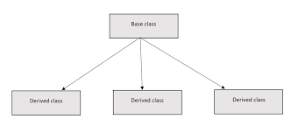
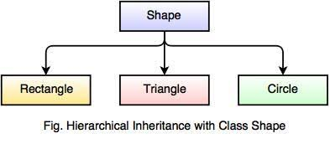

Slide 28
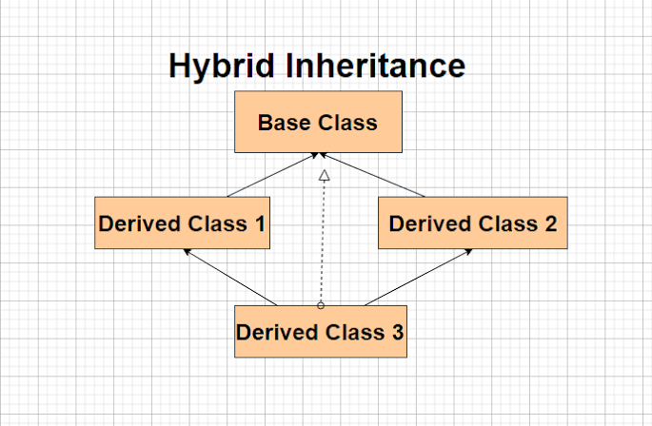
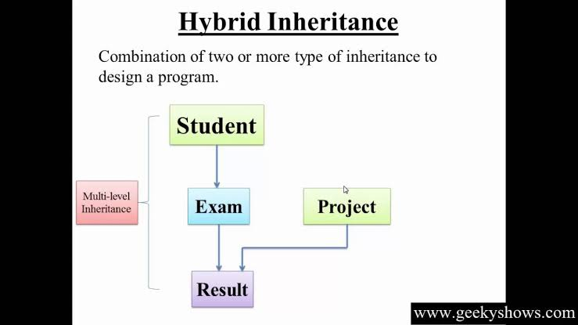

Slide 29
Inheritance and Polymorphism
Inheritance
One class of objects takes on characteristics of another class and extends them
Superclass → subclass
Generalization/specialization hierarchy
Also called an inheritance hierarchy
Result of extending class into more specific subclasses
This is an important concept!!

Slide 30
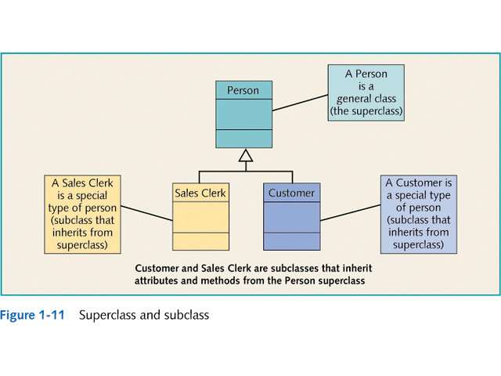

Slide 31
Polymorphism
Polymorphism is originally a Greek word that means the ability to take multiple forms.
In object-oriented paradigm, polymorphism implies using operations in different ways, depending upon the instance they are operating upon.
Polymorphism allows objects with different internal structures to have a common external interface. Polymorphism is particularly effective while implementing inheritance.

Slide 32
Inheritance and Polymorphism
Polymorphism
literally means “many forms”
in Java means using the same message (or method name) with different classes
different objects can respond in their own way to the same message
e.g. toString()

Slide 33
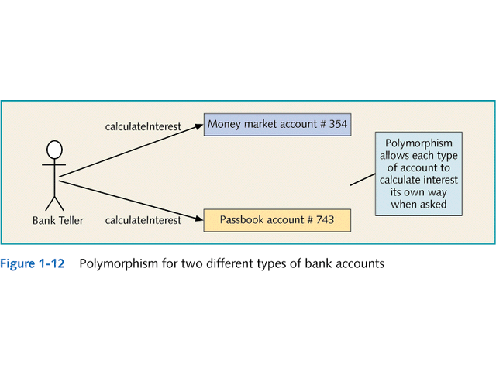

Slide 34
Association
Association is a group of links having common structure and common behavior. Association depicts the relationship between objects of one or more classes. A link can be defined as an instance of an association.
Degree of an Association
Degree of an association denotes the number of classes involved in a connection. Degree may be unary, binary, or ternary.
A unary relationship connects objects of the same class.
A binary relationship connects objects of two classes.
A ternary relationship connects objects of three or more classes.

Slide 35
Cardinality Ratios of Associations
Cardinality of a binary association denotes the number of instances participating in an association. There are three types of cardinality ratios, namely −
One–to–One − A single object of class A is associated with a single object of class B.
One–to–Many − A single object of class A is associated with many objects of class B.
Many–to–Many − An object of class A may be associated with many objects of class B and conversely an object of class B may be associated with many objects of class A.

Slide 36
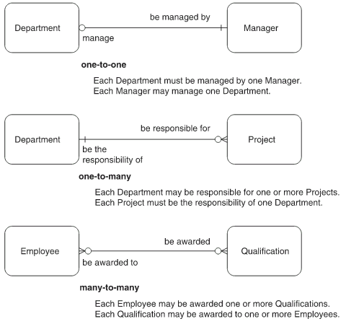
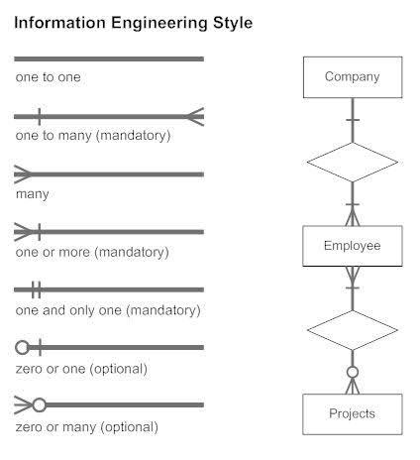

Slide 37
Objects relationships: Association
Associations:
Bidirectional
Cardinality
One to one
One to many
Many to many
Consumer-Producer Association
Pilot
flown
Planes
fly
Printserver
Requesting
Item

Slide 38
Aggregation or Composition
Aggregation or composition is a relationship among classes by which a class can be made up of any combination of objects of other classes.
It allows objects to be placed directly within the body of other classes.
Aggregation is referred as a “part–of” or “has–a” relationship, with the ability to navigate from the whole to its parts. An aggregate object is an object that is composed of one or more other objects.

Slide 39
Aggregation or Composition
Example
In the relationship, “a car has–a motor”, car is the whole object or the aggregate, and the motor is a “part–of” the car. Aggregation may denote −
Physical containment − Example, a computer is composed of monitor, CPU, mouse, keyboard, and so on.
Conceptual containment − Example, shareholder has–a share.

Slide 40
Objects relationships: Aggregation

Slide 41
Aggregation
All objects except the most basic ones, composed of and may contain other objects.
eg: Spread sheets composed of cells and cells are objects contains texts, mathematical formulas,videos,etc..
Each objects has an identity, one object can refer other objects

Slide 42
Static vs Dynamic Binding
Static Binding: The binding which can be resolved at compile time by compiler is known as static or early binding. Binding of all the static, private and final methods is done at compile-time .
Dynamic Binding: In Dynamic binding compiler doesn’t decide the method to be called. Overriding is a perfect example of dynamic binding. In overriding both parent and child classes have same method .

Slide 43
Main()
{,..
..
..
Add()
}
Add()
{
}

Slide 44
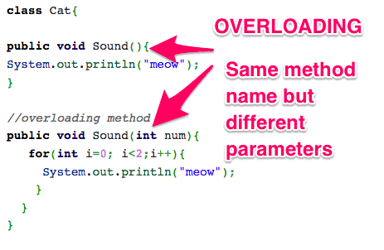
Overloading occurs when two or more methods in one class have the same method name but different parameters.

Slide 45
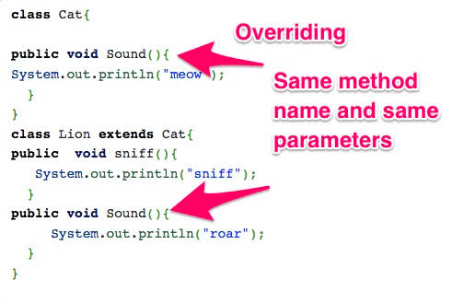
Overriding means having two methods with the same method name and parameters (i.e., method signature). One of the methods is in the parent class and the other is in the child class.

Slide 46
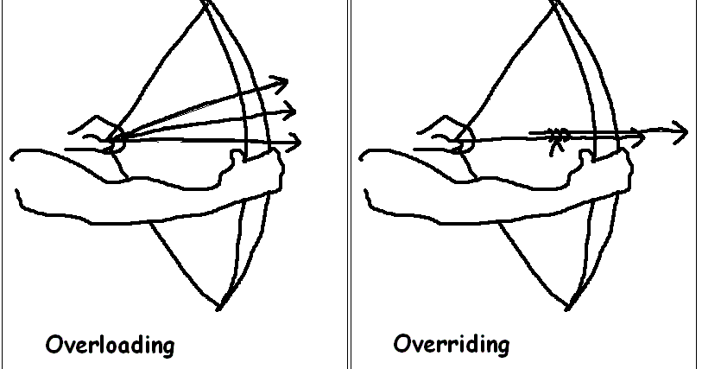

Slide 48
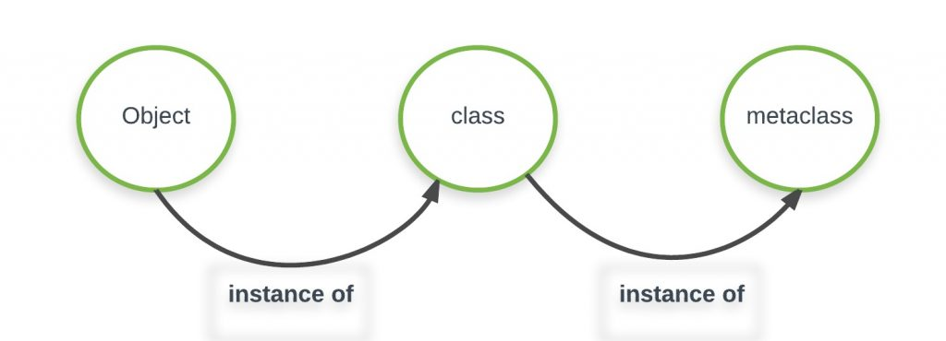
Meta-Classes

Slide 49
A Class is also an object, and just like any other object it’s a instance of something called Metaclass.
A special class type creates these Class object.
The type class is default metaclass which is responsible for making classes.

Slide 50
Reference
“Object Oriented Systems Development using the unified modeling language” Ali Bahrami, TATA McGraw-Hill Edition.

